Slide 1


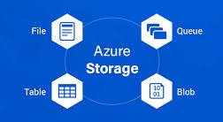


Slide 2
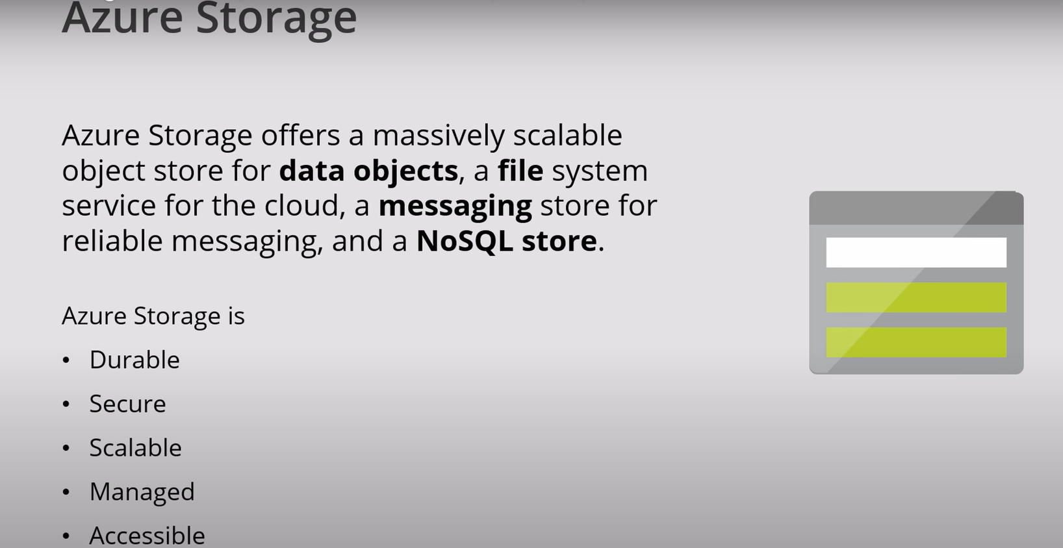

Slide 3
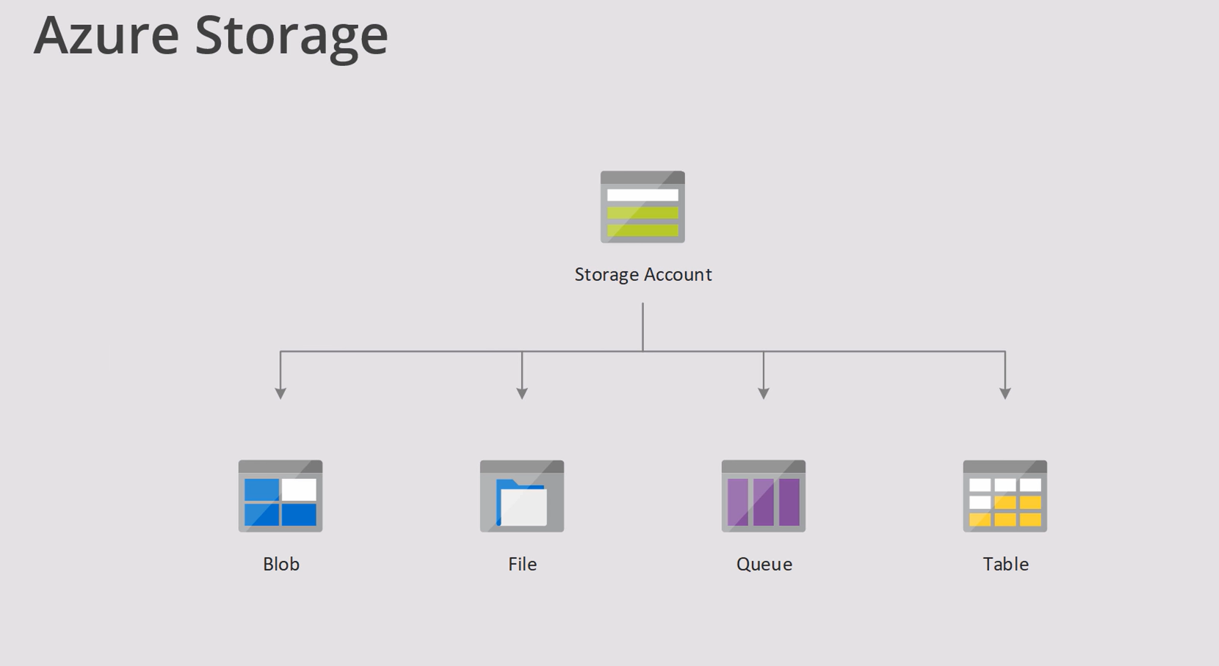

Slide 4
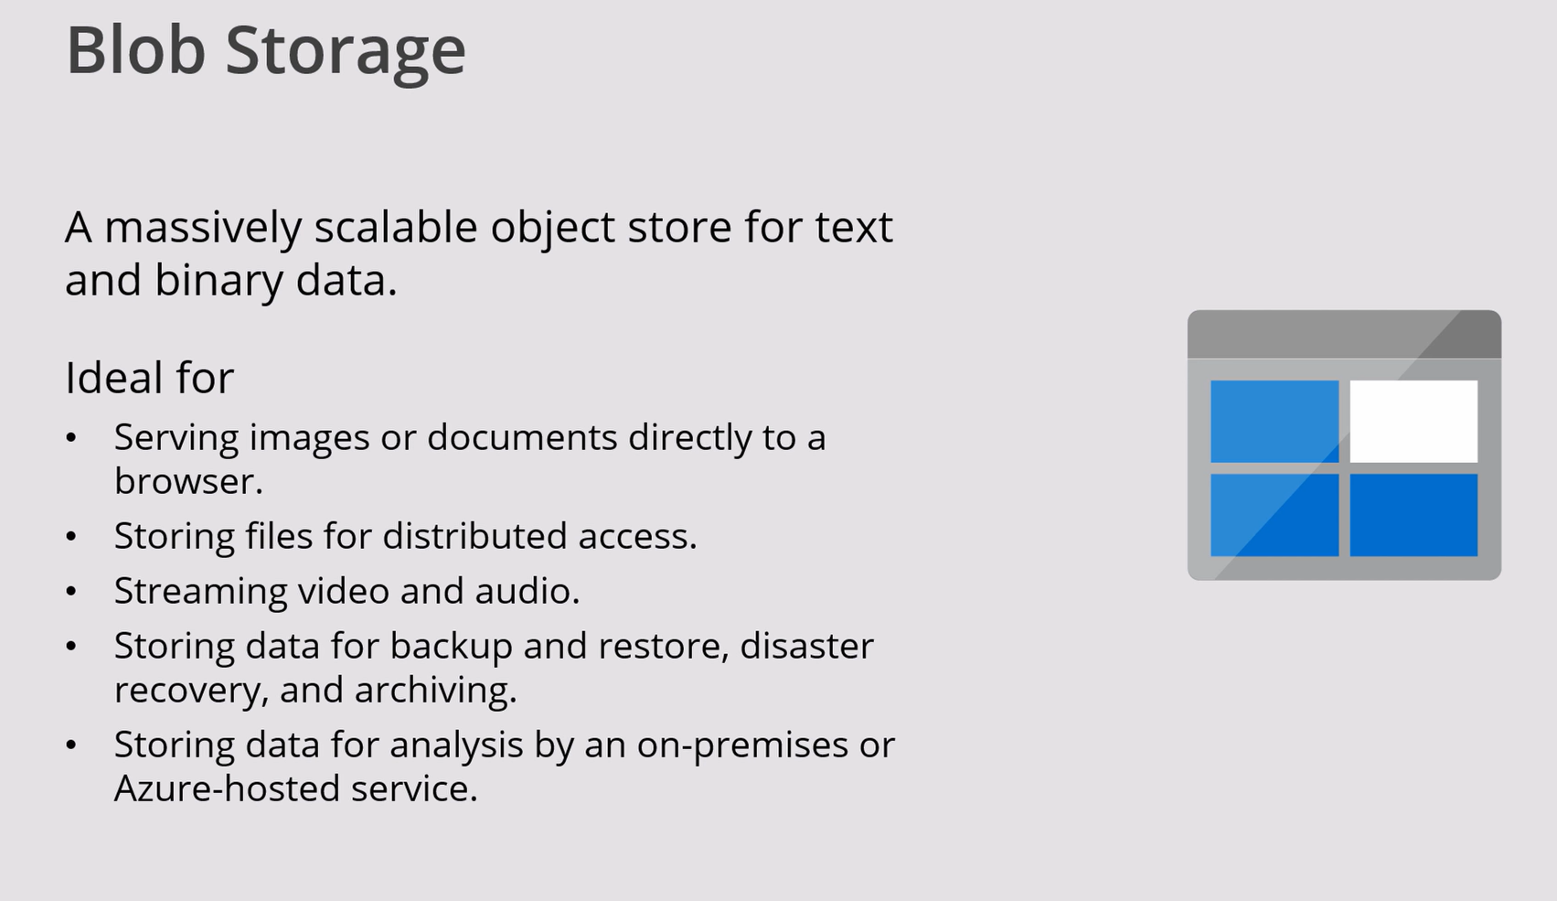

Slide 5
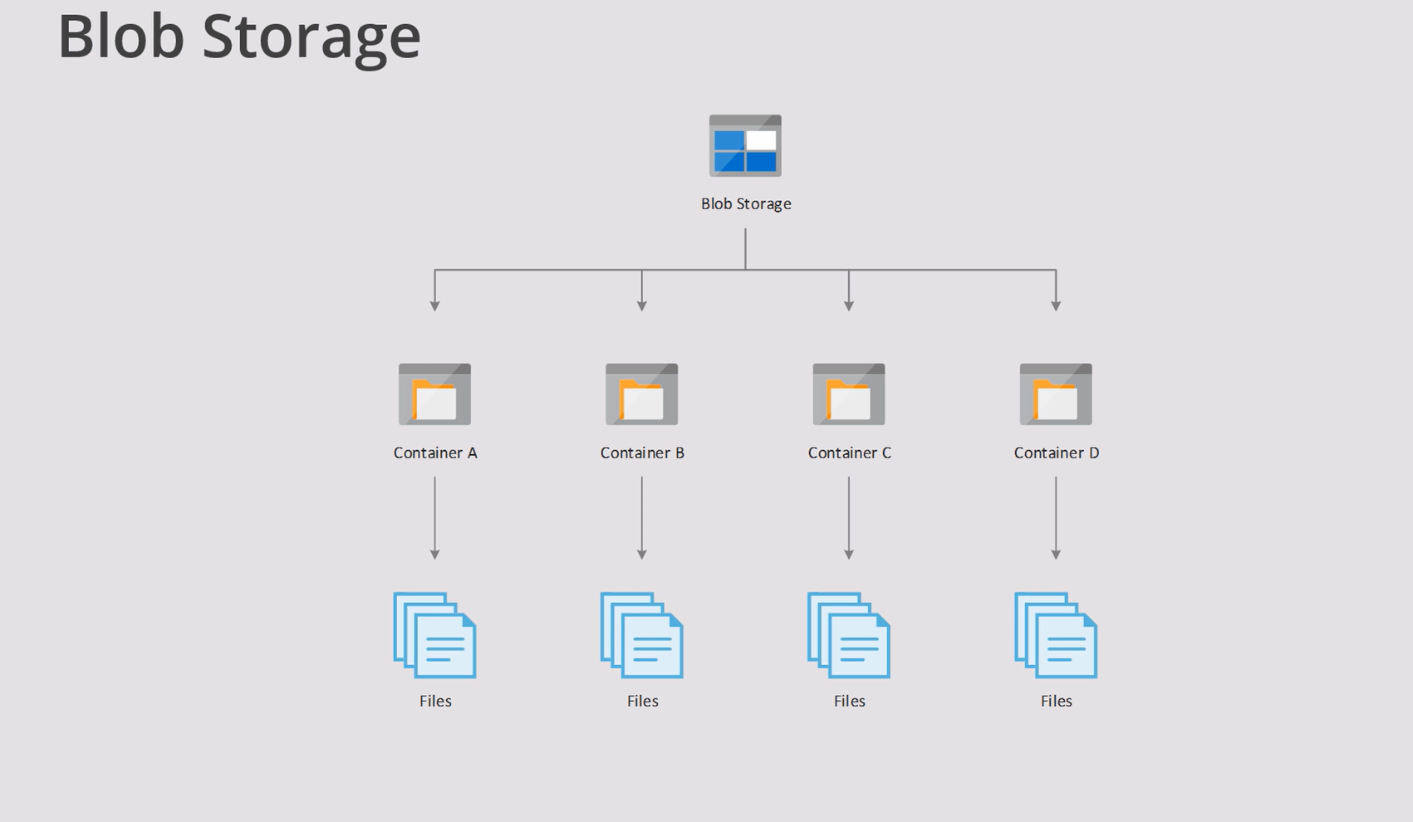

Slide 6
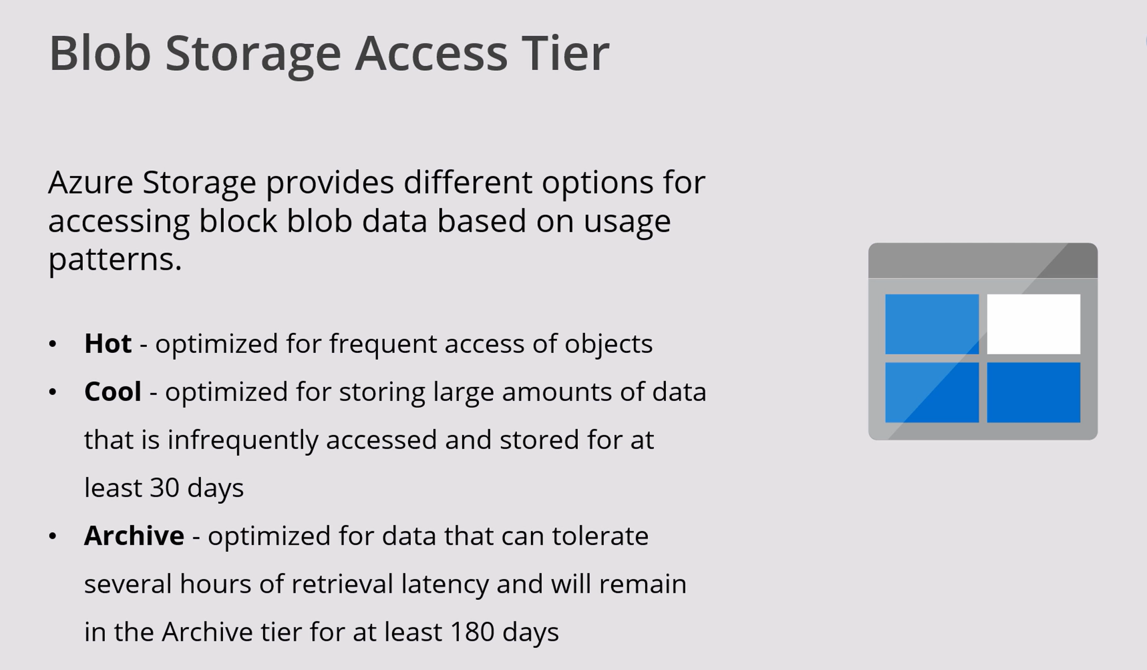

Slide 7
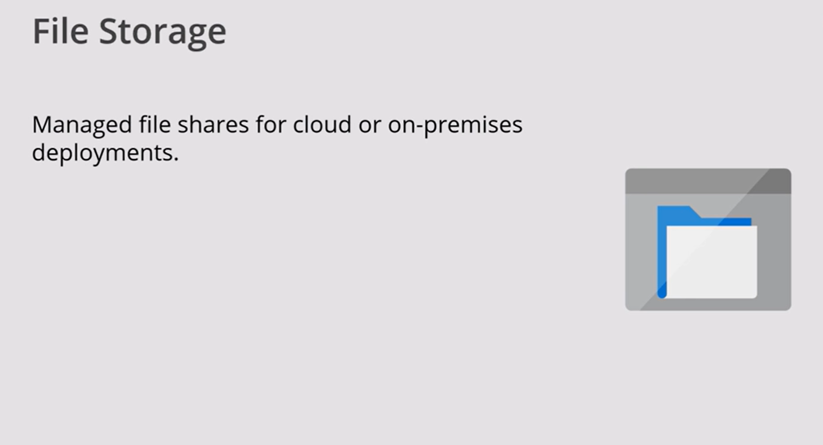

Slide 8
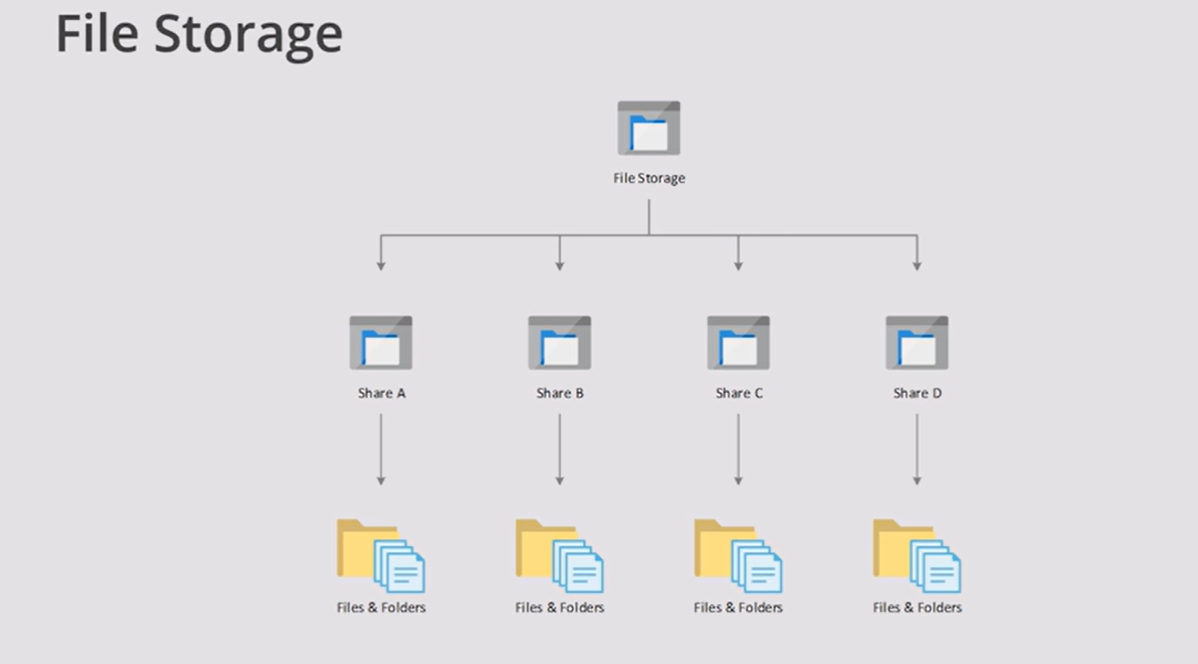

Slide 9
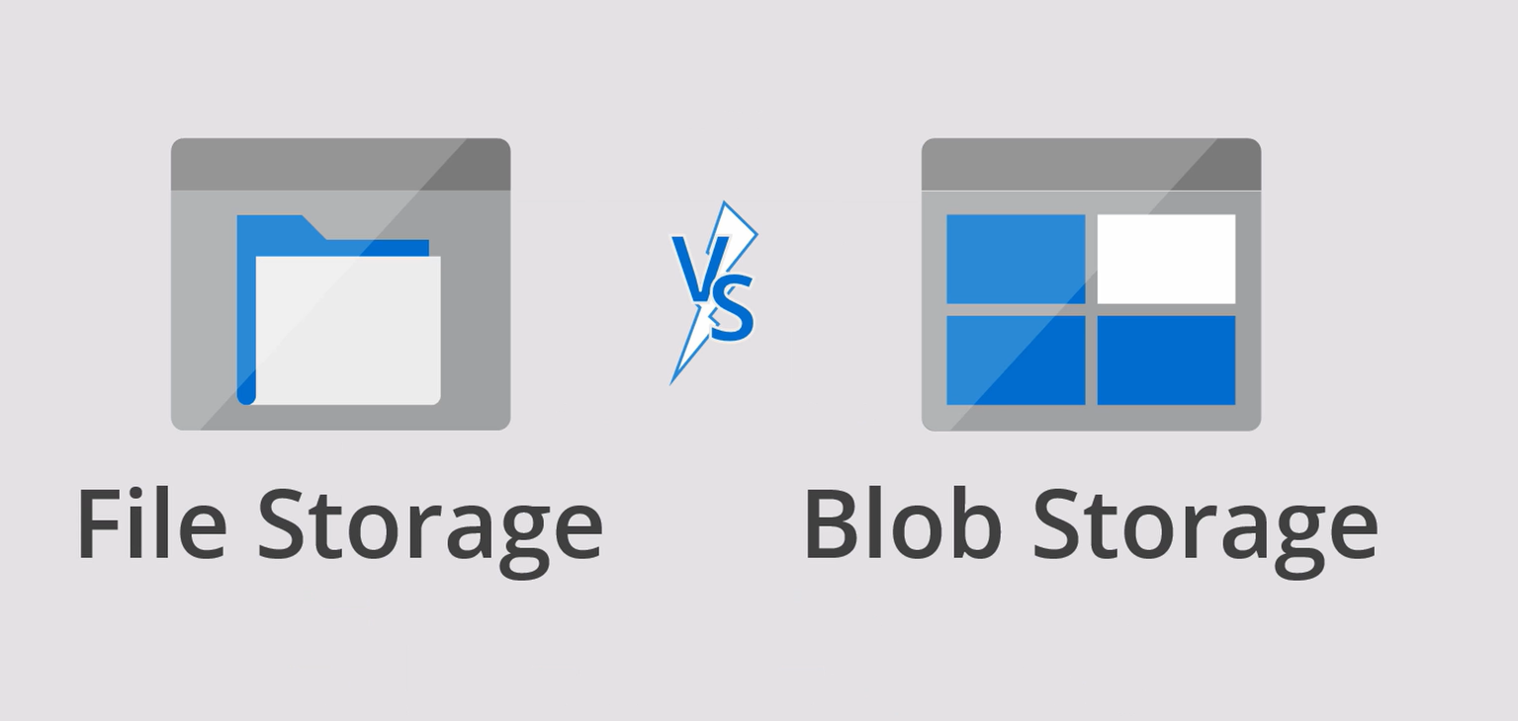
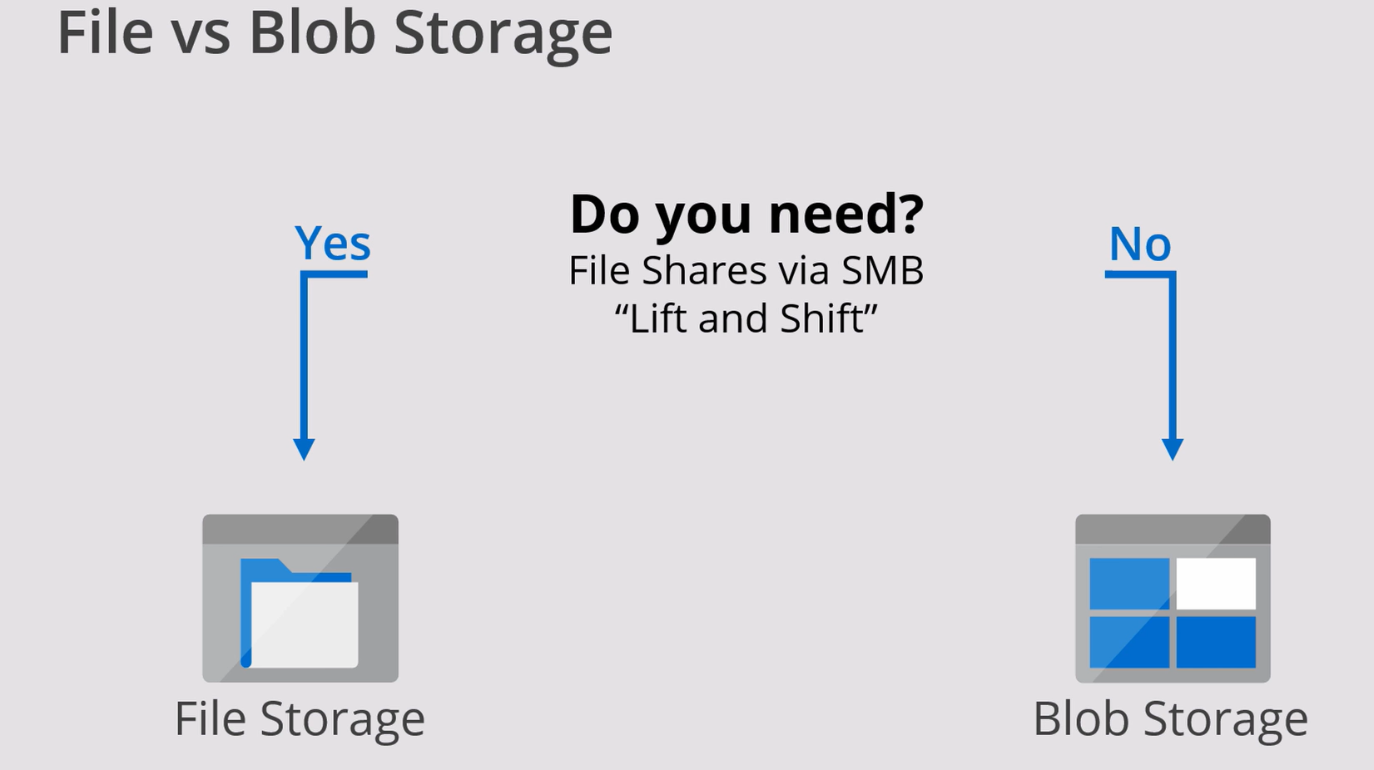

Slide 10
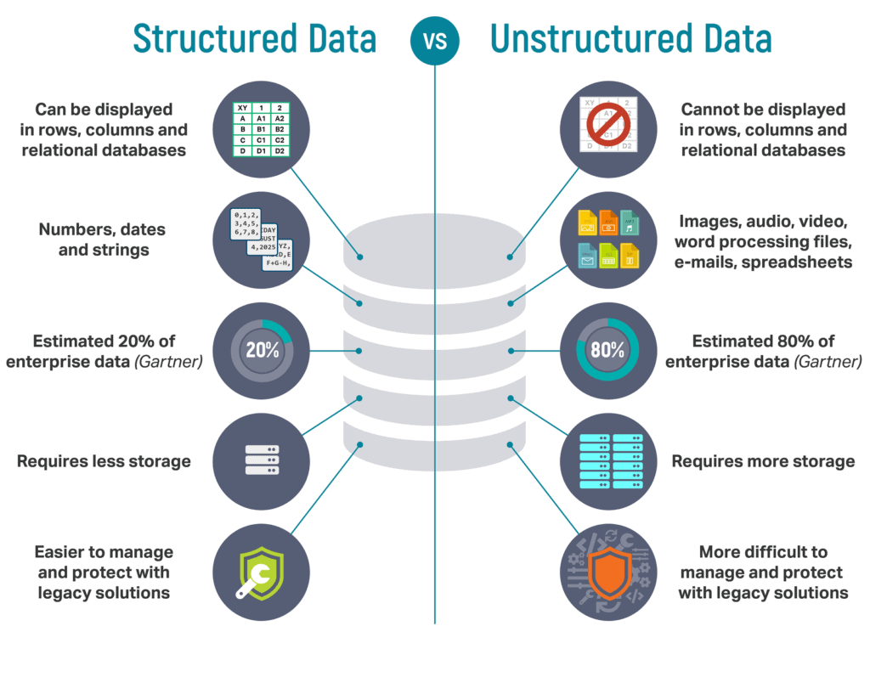

Slide 11
SMB stands for Server Message Block. It's a communication protocol that allows computers to share files, printers, and other resources across a network. SMB is a key feature of Microsoft Windows network services.
SMB is a client/server communication protocol that allows clients to communicate and share files with each other by using the server as a mediator. It also provides a secure and controlled method for opening, reading, moving, creating, and updating files on remote servers.
Use of Blob Storage :
Azure Blob Storage was designed to serve specific needs. If your business use case needs to store unstructured data like audio, video, images, etc then you should probably go with this option. The objects that are being stored in Blob does not necessarily have an extension.
The following points describe the use case scenarios:
Serving images or documents directly to a browser
Storing Files for distributed access
Streaming video and audio
Writing to log Files
Storing data for backup, restore, disaster recovery and archiving
Storing data for analysis by an on-premises or Azure-hosted service
Use of File Storage :
File Storage can be used if your business use case needs to deal mostly with standard File extensions like *.docx, *.png and *.bak then you should probably go with this storage option.
The following points describe the use case scenarios:
Replace or supplement on-premises File servers
“Lift and shift” applications
Simplify cloud development

Slide 12
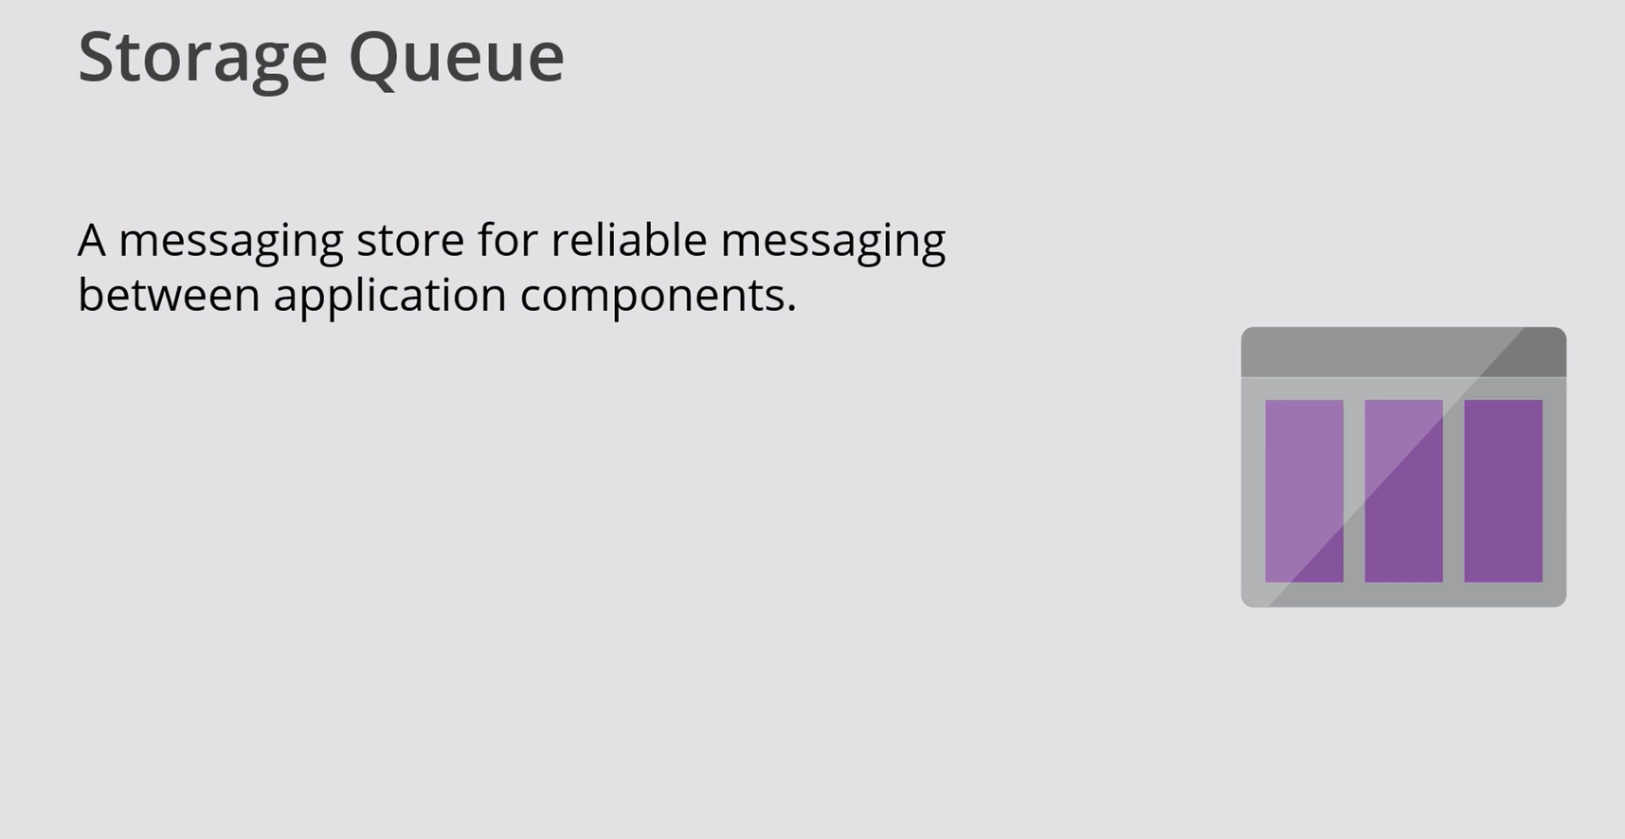

Slide 13
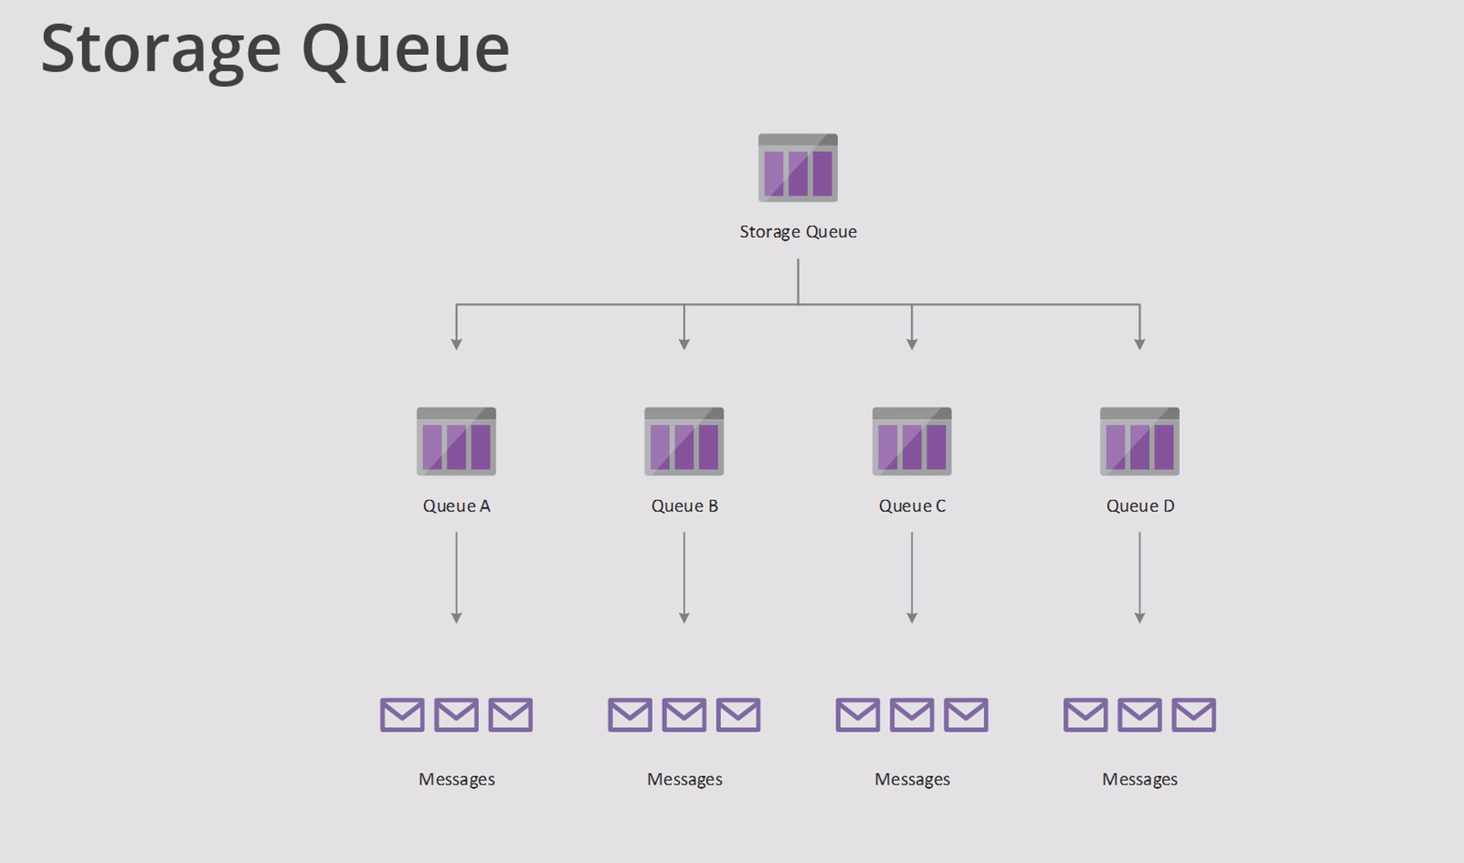

Slide 14
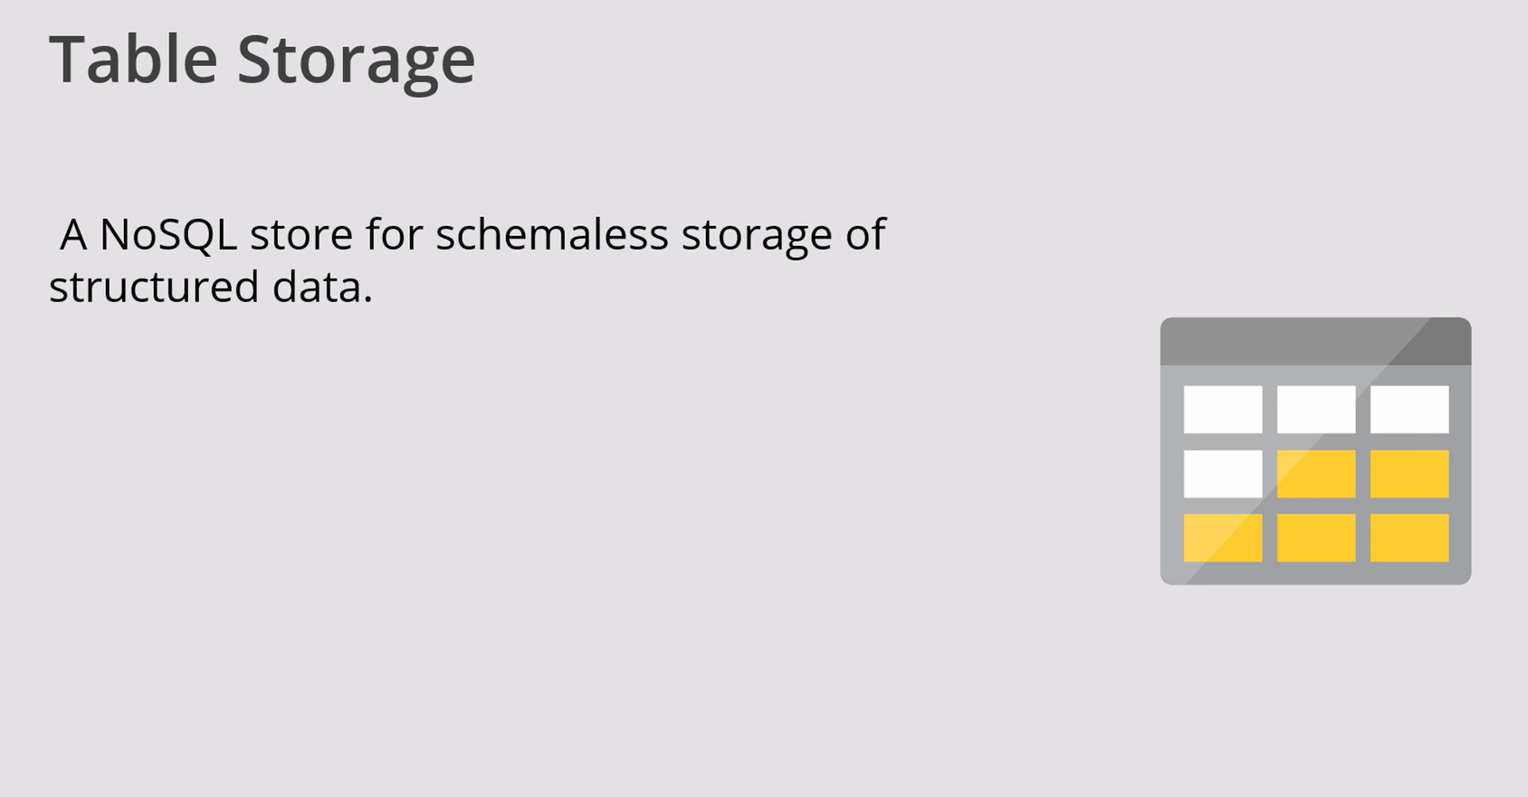

Slide 15
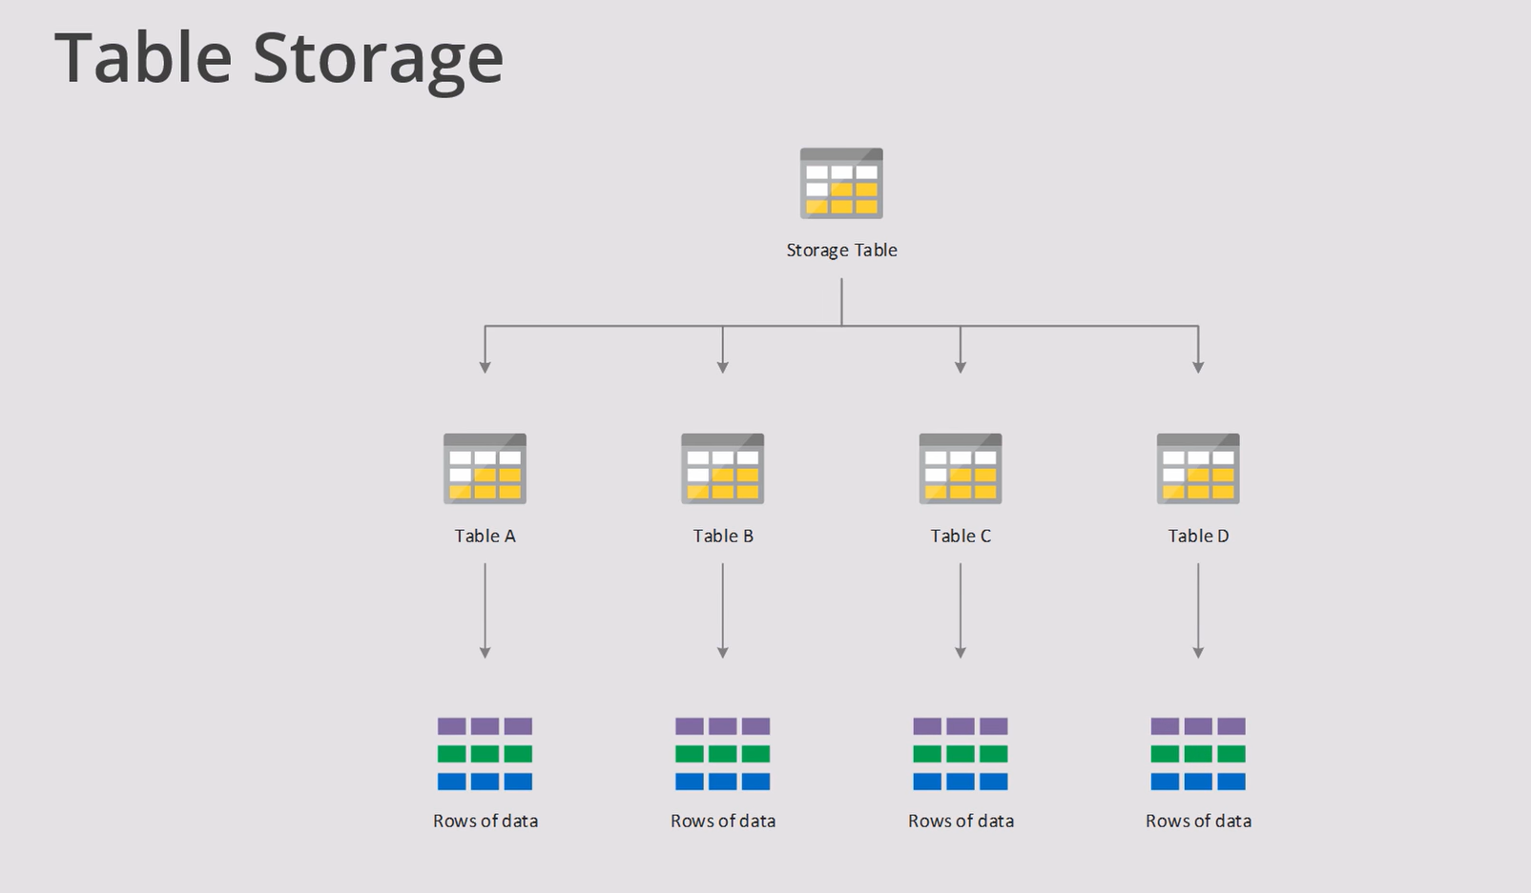

Slide 16
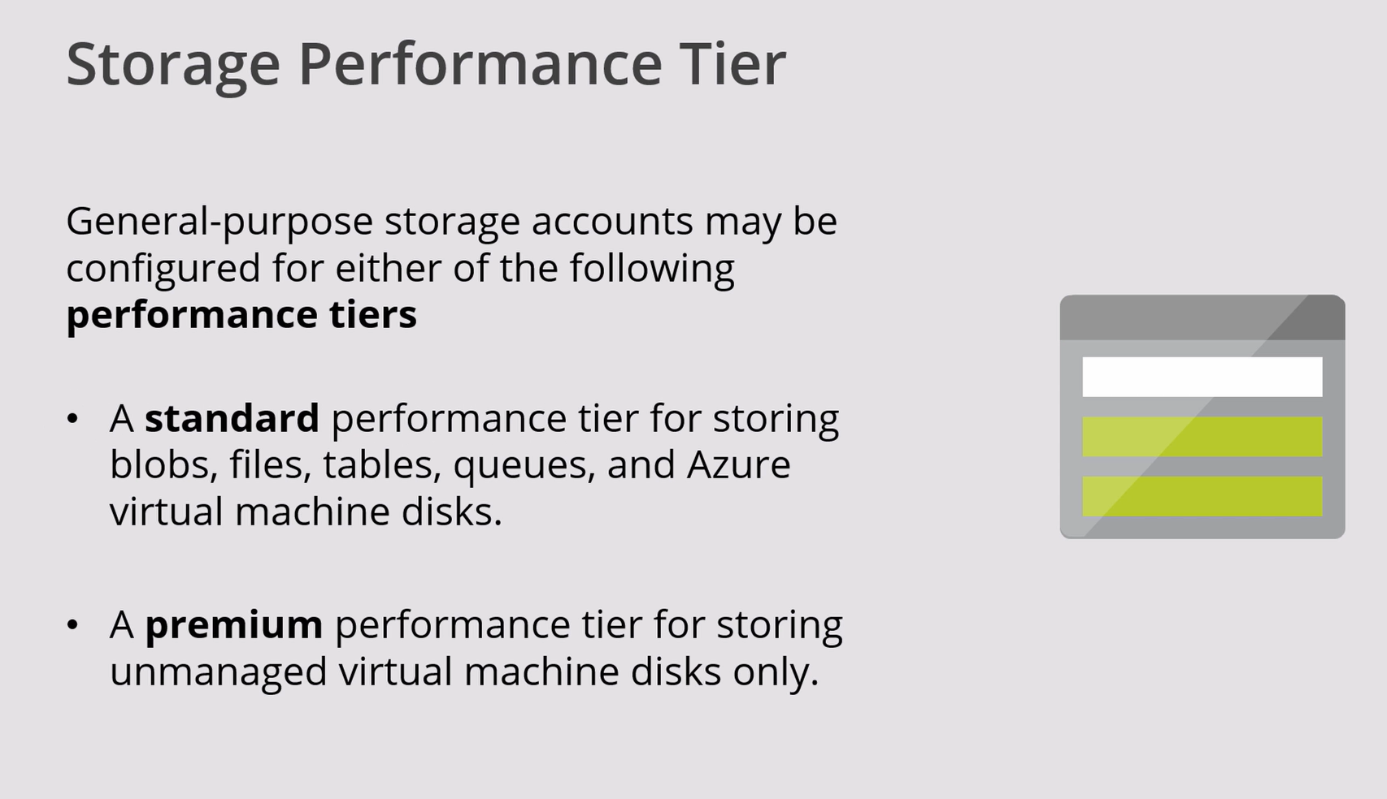

Slide 17
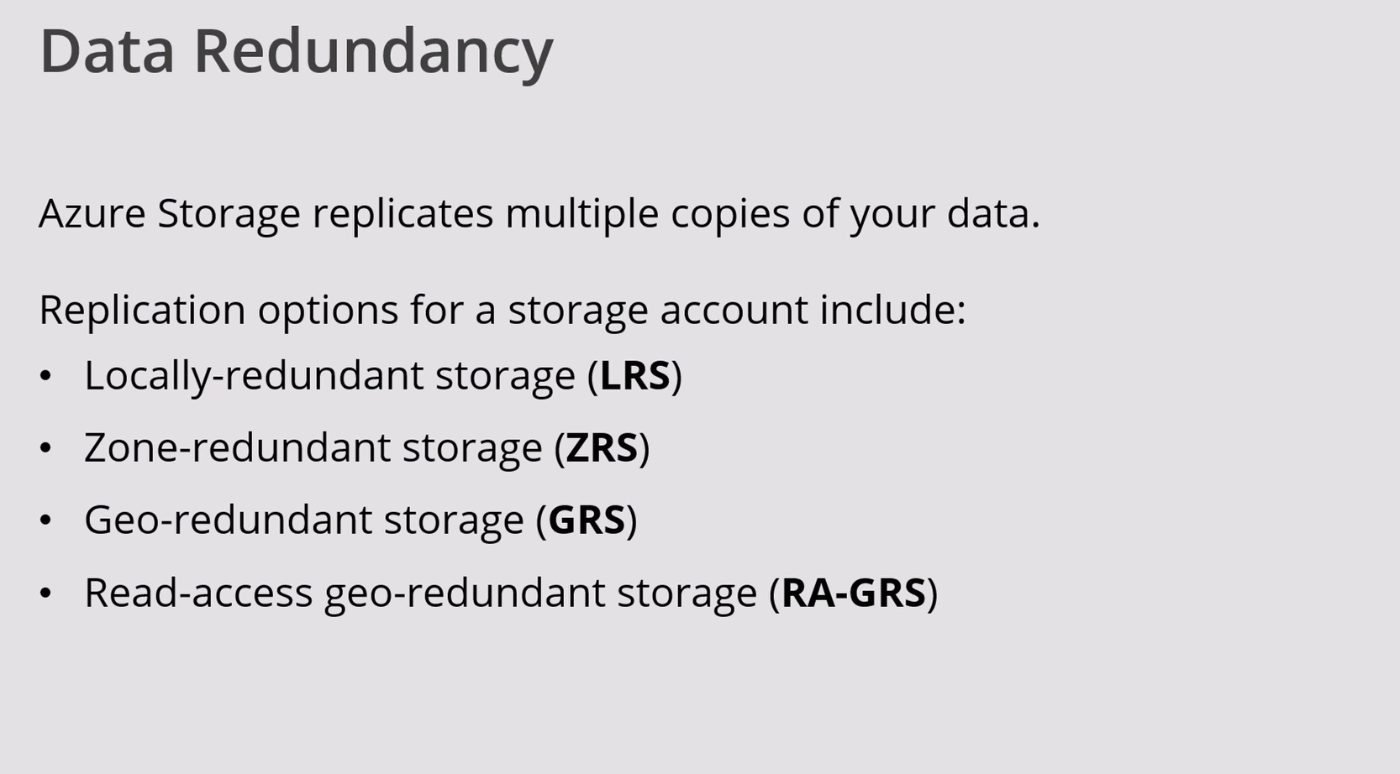

Slide 18
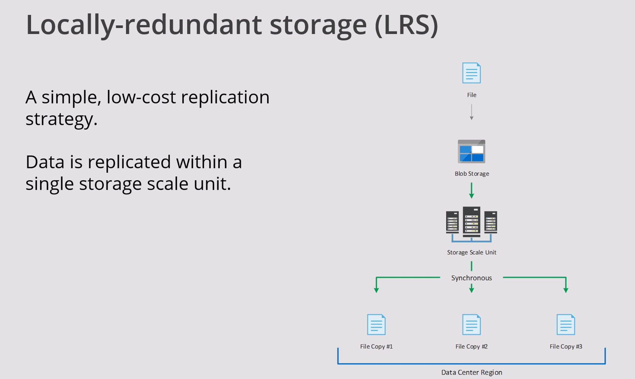

Slide 19
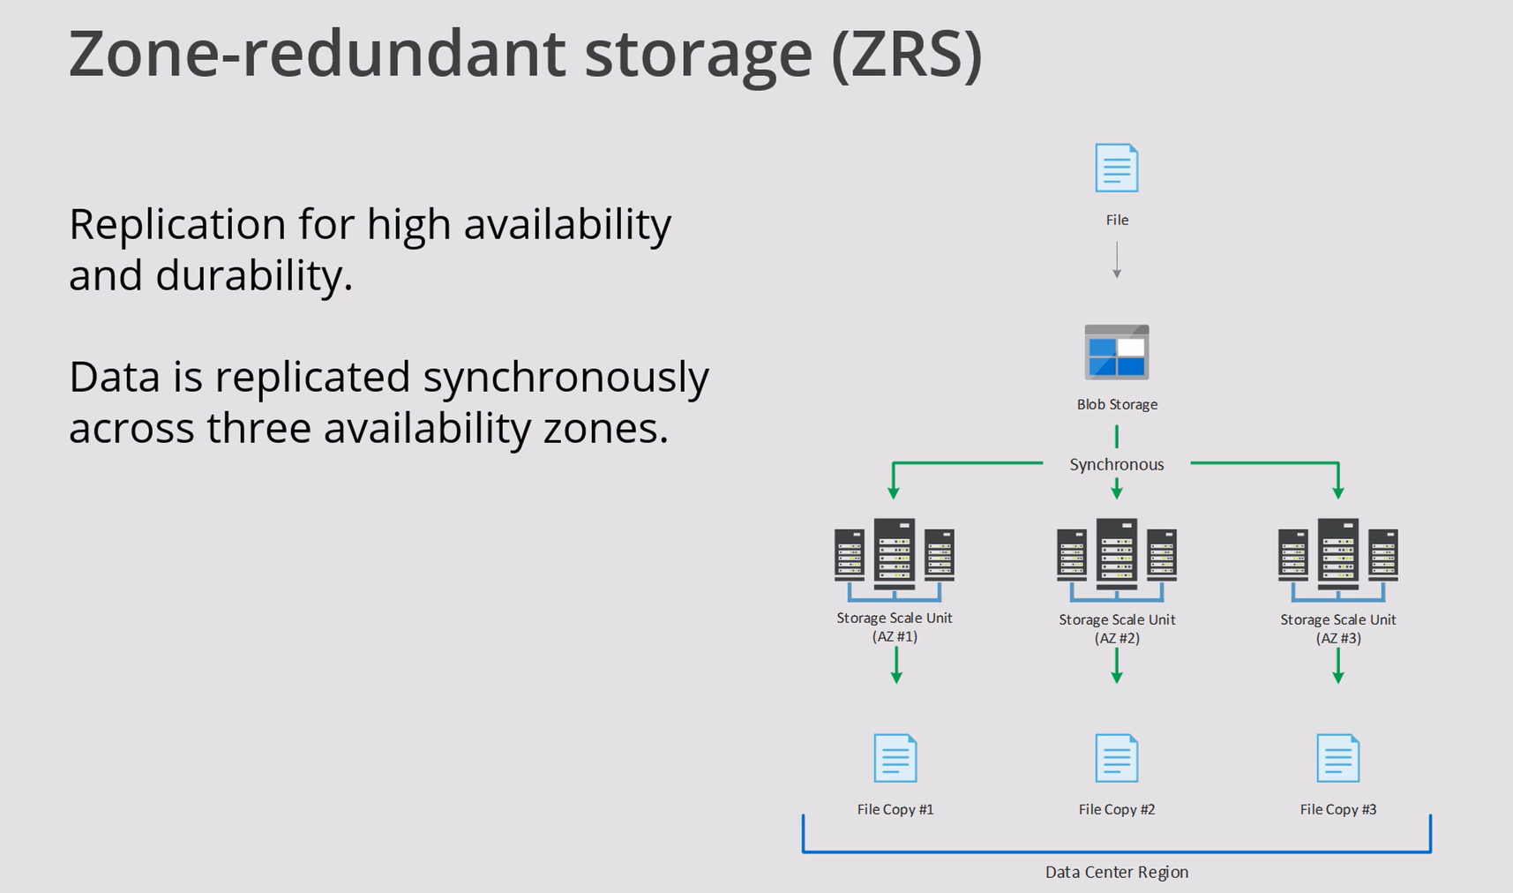

Slide 20
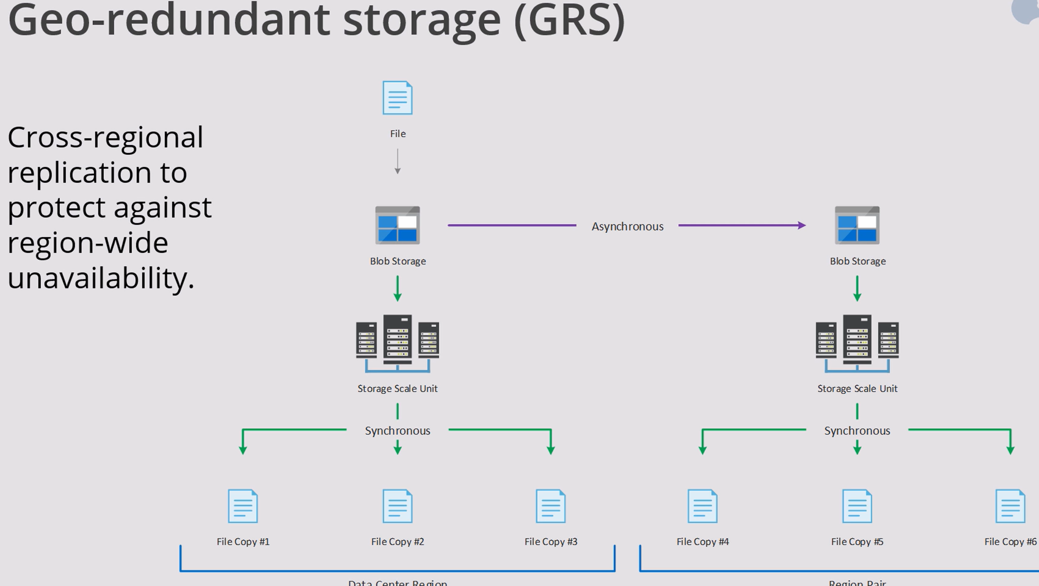

Slide 21
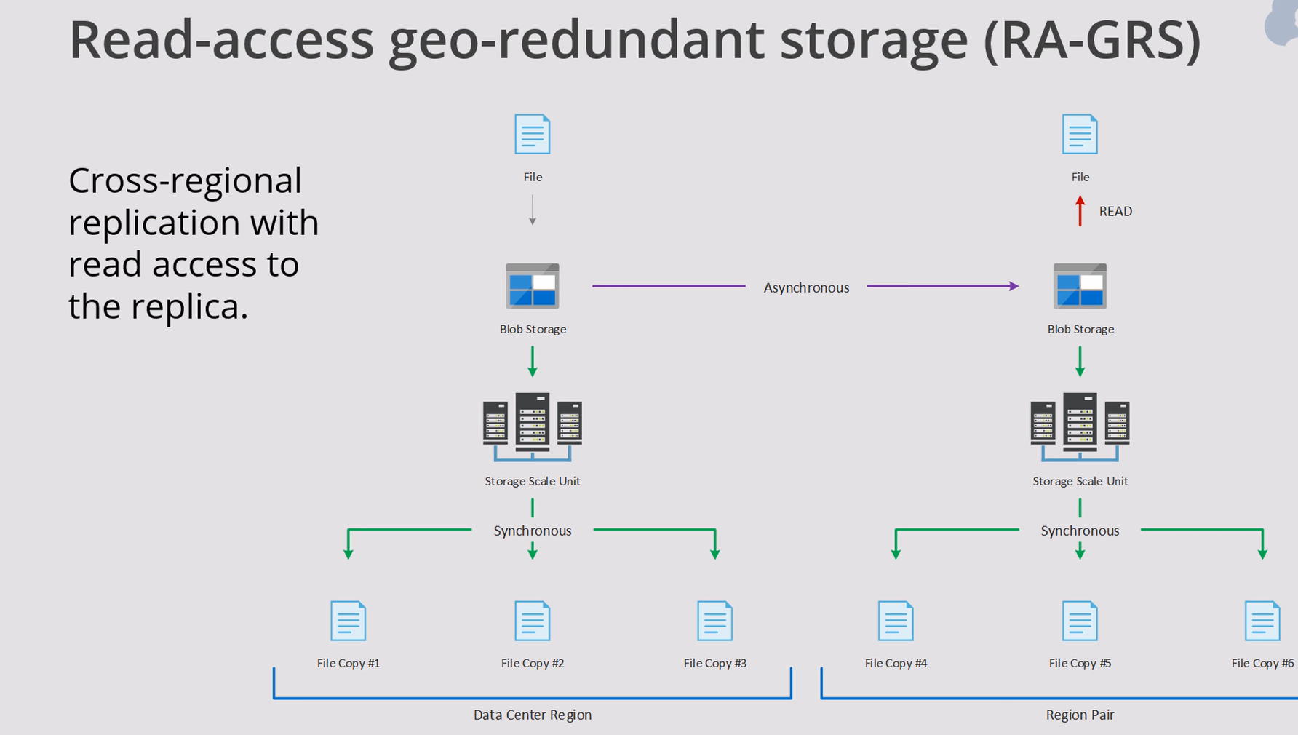

Slide 22
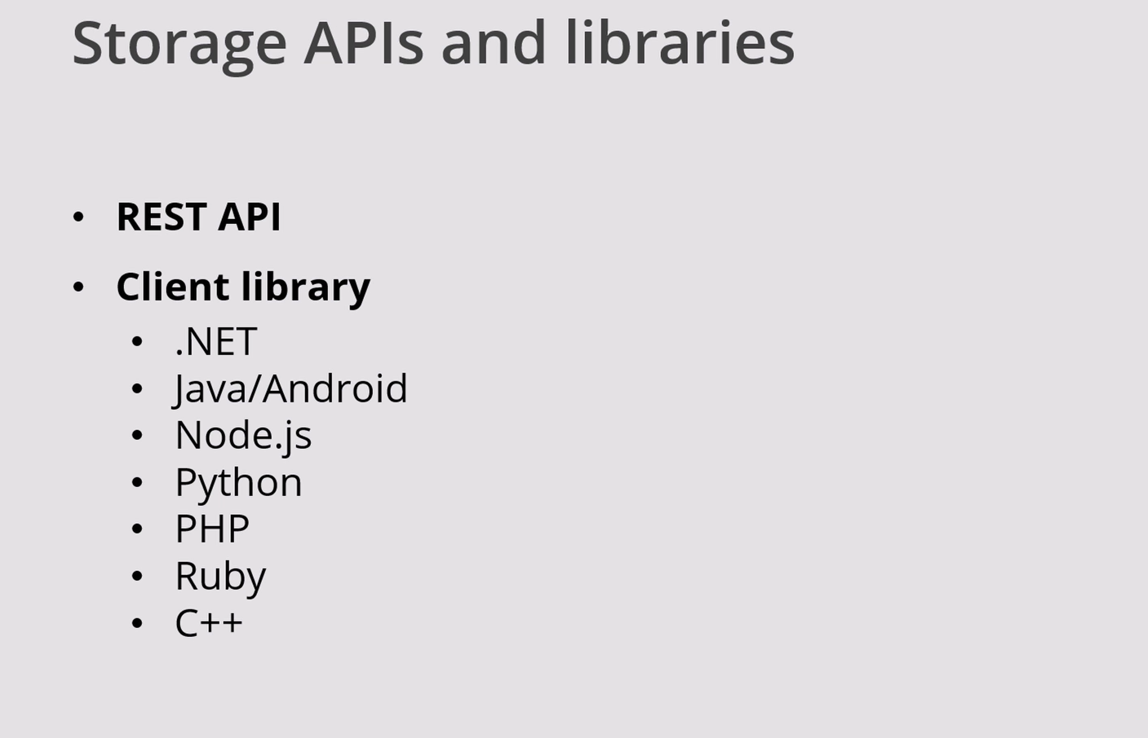

Slide 23


